Slide 1
Sorting Algorithms
Insertion sorting, selection sorting

Slide 2
Insertion Sorting
This is an in-place comparison-based sorting algorithm. Here, a sub-list is maintained which is always sorted.
For example, the lower part of an array is maintained to be sorted. An element which is to be 'inserted’ in this sorted sub-list, has to find its appropriate place and then it has to be inserted there. Hence the name, insertion sort.

Slide 3
Insertion sorting
The array is searched sequentially and unsorted items are moved and inserted into the sorted sub-list (in the same array).
This algorithm is not suitable for large data sets as its average and worst case complexity are of Ο(n²), where n is the number of items.

Slide 4

How Insertion Sort Works?
Insertion sort compares the first two elements.

Slide 5

How Insertion Sort Works?
It finds that both 14 and 33 are already in ascending order. For now, 14 is in sorted sub-list.

Slide 6

How Insertion Sort Works?
Insertion sort moves ahead and compares 33 with 27.

Slide 7

How Insertion Sort Works?
And finds that 33 is not in the correct position.

Slide 8

How Insertion Sort Works?
Finally we have a list of 4 , 4 items in array in a sorted form

Slide 9
Algorithm for insertion sort
Step 1 − If it is the first element, it is already sorted. return 1;
Step 2 − Pick next element
Step 3 − Compare with all elements in the sorted sub-list
Step 4 − Shift all the elements in the sorted sub-list that is greater than the
value to be sorted
Step 5 − Insert the value
Step 6 − Repeat until list is sorted

Slide 10
Selection Sorting
Selection sort is a simple sorting algorithm. This sorting algorithm is an in-place comparison-based algorithm in which the list is divided into two parts, the sorted part at the left end and the unsorted part at the right end. Initially, the sorted part is empty and the unsorted part is the entire list.
The smallest element is selected from the unsorted array and swapped with the leftmost element, and that element becomes a part of the sorted array. This process continues moving unsorted array boundary by one element to the right.
This algorithm is not suitable for large data sets as its average and worst case complexities are of Ο(n²), where n is the number of items.

Slide 11

How Selection Sort Works?
Let us we have an array:

Slide 12

How Selection Sort Works?
For the first position in the sorted list, the whole list is scanned sequentially. The first position where 14 is stored presently, we search the whole list and find that 10 is the lowest value.

Slide 13

How Selection Sort Works?
So we replace 14 with 10. After one iteration 10, which happens to be the minimum value in the list, appears in the first position of the sorted list.

Slide 14

How Selection Sort Works?
For the second position, where 33 is residing, we start scanning the rest of the list in a linear manner.

Slide 15

How Selection Sort Works?
We find that 14 is the second lowest value in the list and it should appear at the second place. We swap these values.

Slide 16
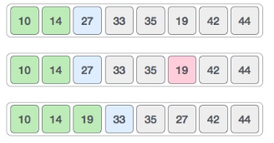
How Selection Sort Works?
The same process is applied to the rest of the items in the array.
Following is a pictorial depiction of the entire sorting process

Slide 17
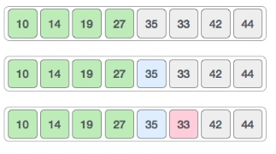
How Selection Sort Works?

Slide 18
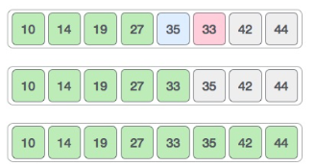
How Selection Sort Works?

Slide 19
Algorithm for selection sorting
Step 1 − Set MIN to location 0
Step 2 − Search the minimum element in the list
Step 3 − Swap with value at location MIN
Step 4 − Increment MIN to point to next element
Step 5 − Repeat until list is sorted

